Slide 1
현대모비스 보안 코딩/오픈소스 취약점 점검 보안 사양서
협력사 가이드용 v1
2026.02
사이버보안검증실

Slide 2
보안 등급
Secure Coding Requirements (ES95489-23, rev 2 based)
Evaluation Target : All ECU’s SW adopted on vehicles
  Programming language : SW developed by C/CPP/JAVA
  Evaluated the individual assessment units of SW
  Opensource SW is excluded from the evaluation spec, but should satisfy ES95489-24 instead
  All SW except for Opensource should be evaluated
Scopes of Evaluation :
- Secure coding rules that must be complied with by individual programming languages are based on the latest Secure Coding guide for Automotive embedded system(v4.1)
(Refer to each document through the automotive security information management system)
  If multiple development languages are used, the each of the secure coding criteria should be satisfied respectively.
  If multiple units exist, the each of units should be evaluated and satisfied.
  Each individual unit of assessment shall be evaluated for all secure coding rules specified in the Development Language Specific Secure Coding Guide document corresponding to each programming language
Evaluation Method : Perform one or more of following 3 method.
  Static analysis tool : Multiple combination can be used.
  Code Review
  Development Document

Slide 3
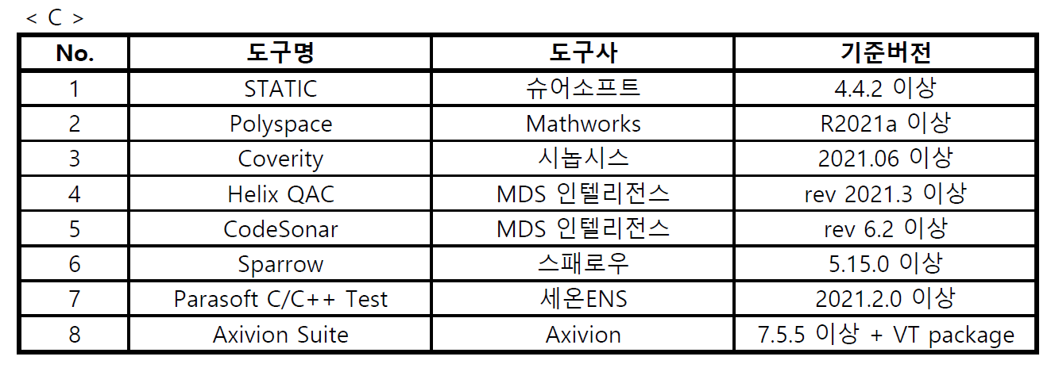
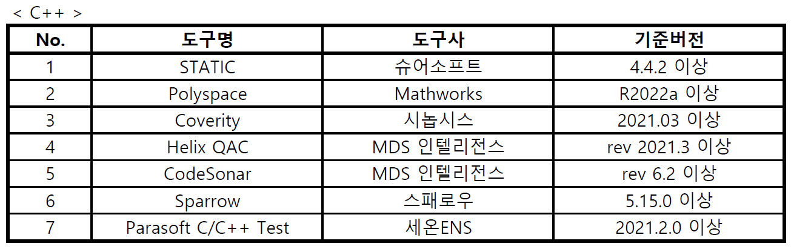
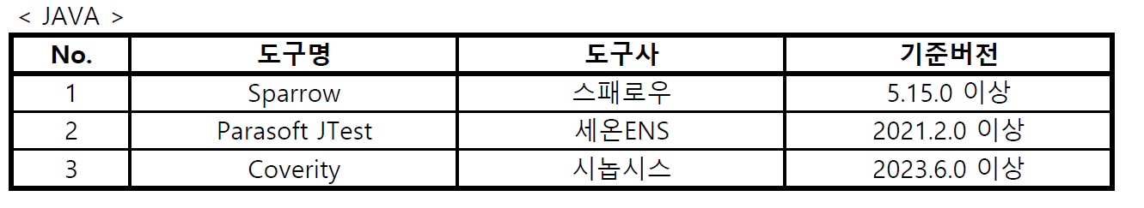
보안 등급
Secure Coding Requirements (ES95489-23, rev 2 based)
Tool Specification : Should use static analysis tools and versions that satisfy the conditions of the ‘Secure Coding Tool Pool’ for each programming language
[24.07.12 Static analysis tool pool list]
※ Request directly through the ES95489-23 specification owner to register a tool in the Pool
ㄴ Tools criteria : Support for more than 95% of all rules of the secure coding guide for each development language and for all rules of severity ‘high’ by development language
In the case of rules that are considered inappropriate for analysis through static analysis tool, it is considered that analysis of the rules is supported when the guide is provided.
Time of evaluation and submission: at the time of submission of the final version of the SW by vehicle development stage
- Resubmission is not required if there are no software changes and the results remain unchanged. However, if a change could potentially affect the overall results, resubmission is required even without software modifications

Slide 4
보안 등급
Secure Coding Requirements (ES95489-23, rev 2 based)
Pass Criteria : Each unit must meet the severity-based rule compliance thresholds - 100% for High severity, at least 90% for Medium severity, and at least 90% for Low severity.
  One or more violations of rules are treated as not satisfying the secure coding rules
  The rules of “Reason for justification” are considered to be satisfied (justification reasons should be attached.)
  All secure coding rules specified in the Development Language Specific Secure Coding Guide documents should be evaluated.
Criteria for rules requiring justification : The following are merely representative examples,
and there may be other valid reasons for acceptance.
  - When exceptional cases are explicitly stated in standards or official channels
  - Code that is not included in mass production but is currently included for the event
  - False positives from analysis tools
  - When it is proven that no security vulnerabilities exist
  - When the vehicle manufacturer agrees to accept the risk
  (submission of the agreement document is required)
  ※ The following cases are NOT considered justified:
  - Code is included in the product but not used
  - Lack of explanation proving that no security vulnerabilities exist (If only 'no functional or security issues' is stated, it is considered unjustified)"

Slide 5
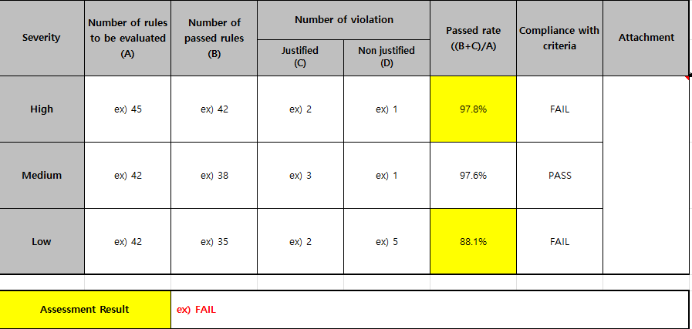
보안 등급
Secure Coding Requirements (ES95489-23, rev 2 based)
Test Report Format :
① All required fields must be completed in accordance with the specified format
  ② The tools and versions used must be specified, and when submitting, you must verify that they are included in the customer's tool pool
  ③ Reports and attachments must be prepared to include English
  ④ Detailed attachments for evaluation results (Attachment section for details)
  - Attach the original report provided by the tool
  - Attach separate analysis results for rules not supported by the tool.
  - Attach detailed information for items requiring justification.
  - Attach mapping documentation between tool checker and the secure coding rules.
  ⑤ Detailed preparation method of the report
  1) Number of rules to be evaluated (A):
  Total number of coding rules by severity specified in the coding guide for each development language
  2) Number of passing rules (B): Number of coding rules for which no violations were found through security coding static analysis tool evaluation or code review
  3) Number of violation rules: Among all violation rules, it is divided into rules with justification(B) and rules without justification(D)
  4) Pass rate : Number of rules to be evaluated / (Number of passing rules + Number of violation rules with justified reasons) , (B+C) / A
  5) Whether the criteria are satisfied: PASS only when both of the following tow items are satisfied
  - Perform evaluation on all rules to be evaluated, that is (A = B + C + D)
  - Satisfy a pass rate above minimum standard for each severity level
  6) Attach details : Attach details of the evaluation carried out and the violation items for which justifications
  (Refer to ④ Detailed attachments for evaluation results )
  7) Evaluation result: If all three items of high, medium, and low severity are PASS, indicate PASS
  ※Create individual sheets for each module and complete them.
  The evaluation sheet name must be specified as ‘EvaluationUnit_Language’(If there are two languages, create two separate sheets)

Slide 6
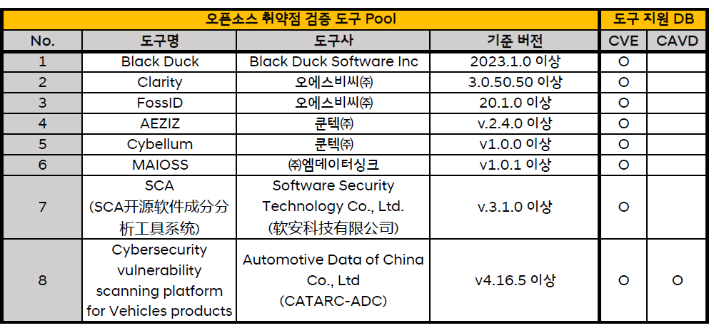
보안 등급
Open-Source SW Vulnerability Scan Specification (ES95489-24, rev5 based)
Scope
  This policy applies to all software deliverables from any company that downloads, uses, or distributes open-source software during the software development process
  If open-source software is used, all requirements defined in this document must be strictly followed
  Even if open-source software is not used, evidence demonstrating non-use must be submitted in accordance with this document.
Requirement – (1) Criteria for Selecting Open-Source Versions
  All open-source software must use the latest version available at the start of development.
  If a vulnerability is discovered in the open-source software during development, the latest version with the applied security patch must be used.
  If applying the latest version is not feasible due to license issues, excessive modification effort, or similar reasons, applying the relevant security patch may be used as an alternative.
Requirement – (2) Criteria for Using Open-Source Vulnerability Scan Tools
  Approved scan tools must be selected from the designated tool pool. (The latest information can be checked through aSIMS system)
  Approved tools and version list (as of 2025-12-17)
※ Effective Date: Applicable to SOP vehicle models starting January 2026.
※ Use of versions below the specified baseline version will not be accepted.
※ To register a tool in the tool pool, a direct request must be made through the ES pecification owner.
※ Criteria for Applying Vulnerability Databases (by country)
- External Connection System ECU (ECS ECU) : CCU, DCU, HU (as of ’25.12.17)
Target Country |  | Target ECU | Mandatory Vulnerability Detection DB | Note
Non-China Country (Europe/Kora/India/Japan..) |  | All ECU | CVE | Refrain from using Chinses Tools (Recommended)
China | Exports | ECS ECU | CVE and CAVD | -
 |  | Other | CVE or CAVD | Selectable
 | Local Production | ECS ECU | CAVD | -
 |  | Other | CVE or CAVD | Selectable

Slide 7
Open-Source SW Vulnerability Scan Specification (ES95489-24, rev5 based)
보안 등급
Requirement – (3) Criteria for Open-Source Vulnerability
  Scan date : only scan results conducted within 6 months prior to submission to the OEM are accepted
  (For vehicles sold in China, scan must be within 5 months prior to the VTA certification audit date)
  Vulnerability DB update: the scan must be performed using the latest vulnerability database as of the scan date.
  Mandatory vulnerability patch criteria
  ① CVE: CVSS v3 base score of 7.0 or higher ② CAVD: Vulnerability detection results rated High or above
  Projects without Open-Source usage : must provide evidence of non-use through the results of a scan tool
  (exception to tool pool requirement)
  For projects without Open-Source usage, scan date requirements do not apply
Requirement – (4) Submission of Test Reports
  Establish the submission schedule in consultation with the Mobis design department
  Customer-required submission timing : ESIR / official release after ESIR / additional submission requests due to vehicle certification such as regulations and VTA.
  Test report template
  Compliance requirements when preparing the test report (If not satisfied, the report may need to be rewritten).
  ① Mandatory completion of required fields according to the template.
  ② The tool and version used must be specified and the tool must be included in the customer’s tool pool.
  ③ The original report provided by the tool must be attached (in the “Attach.” section).
  ④ Evidence of vulnerability database update for the tool used must be submitted.
  ⑤ Input the remediation results for High/Critical vulnerabilities :
  - Patched : provide the official patch URL applied or details proving that the patch was applied.
  - Justified : a justification reason must be provided, along with evidence supporting the justification.
  └ Each CVE must be proven to pose no security risk, and the justification must follow the “How to Write Justification in the Report.”
  - Risk Accepted : In cases of risk acceptance, clear reasons and impact analysis results must be provided, followed by consultation
  with Mobis/customer design departments and approval from relevant executives.

Slide 8
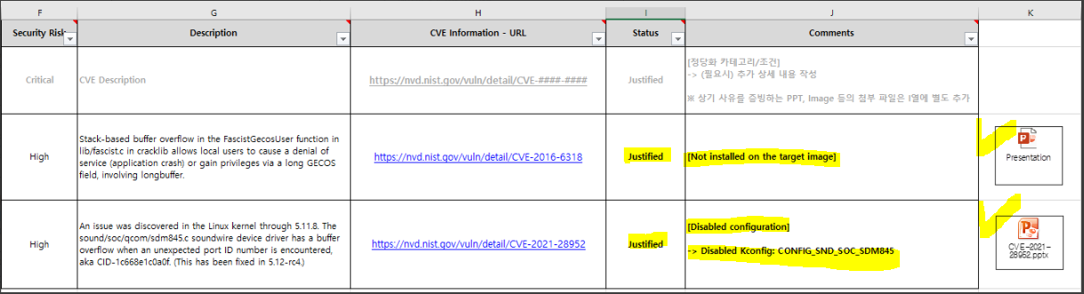
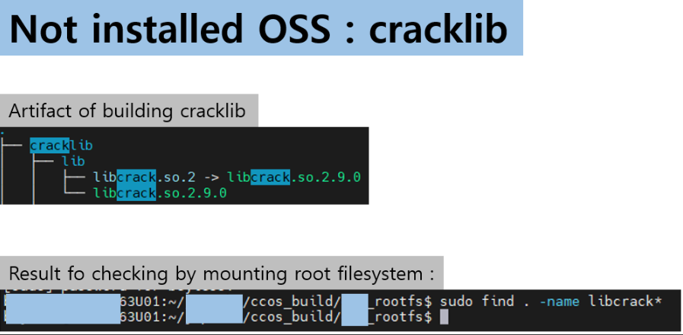
보안 등급
Open-Source SW Vulnerability Scan Specification (ES95489-24, rev5 based)
Requirement – (4) Submission of Test Reports
  Examples of Justification Reasons
  : The justification must clearly state that the identified vulnerability has no impact on the product
  (Do not write reasons such as ‘no abnormal function operation’)
  : The following are only representative examples; other acceptable reasons may exist.
  However, justification can only be finalized through consultation with the OEM
  if there is logical evidence proving no impact on the product.
  ① When the relevant open source is not included in the production firmware, resulting in no impact.
  ② When the settings for functions or areas affected by the CVE vulnerability are disabled resulting in no impact. (e.g., kconfig disable),
  ③ When the OS, architecture, or structure affected by the CVE vulnerability differs, resulting in no impact
  (e.g., a CVE that affects Windows OS).
  ④ When the file or vulnerable function that requires a patch for the CVE vulnerability does not exist in the code, resulting in no impact.
  How to Write Justification in the Report
  : Write the justification reason in a category format so that it can be easily verified during VTA certification using filters and use the tag format
  : Examples of tag [Not installed on the target image], [Disabled configuration], [Disabled feature], [Unsupported Architecture], …
※ Justification comments must be accompanied by
supporting evidence that proves the comment, attached
separately in a PPT or similar format

