Slide 1
Moibs 5차 보드 작업 환경
Trace32

Slide 2
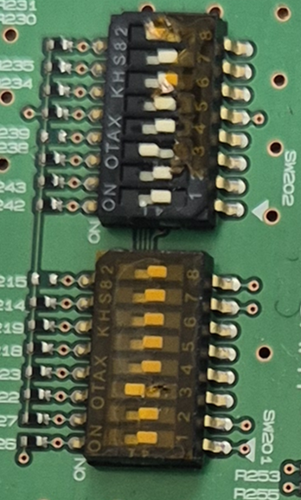
Trace32 attach를 위한 설정
 | SW201 | SW202
1 | OFF | OFF
2 | OFF | OFF
3 | ON | ON
4 | OFF | OFF
5 | OFF | OFF
6 | OFF | OFF
7 | OFF | OFF
8 | OFF | ON

Slide 3
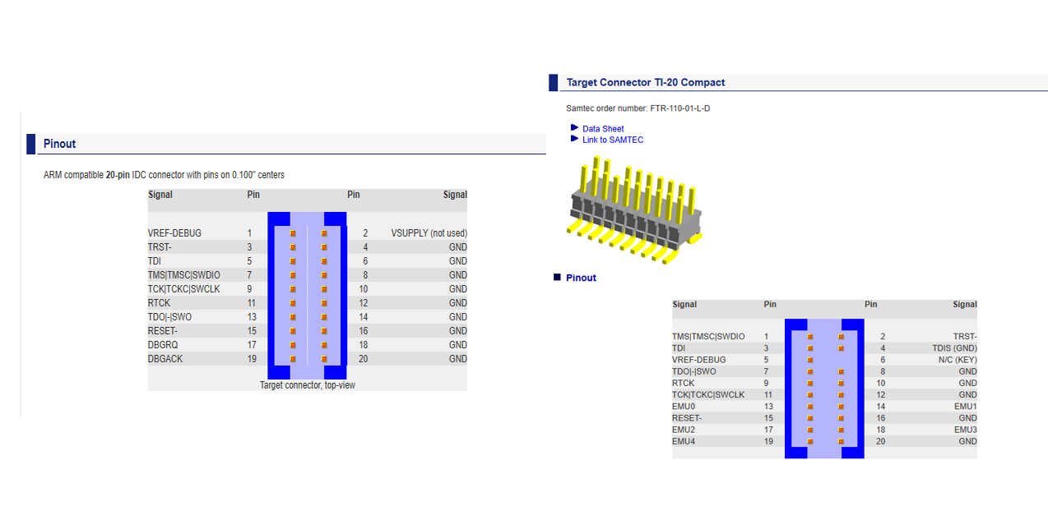
Treace32 Pin 연결

Slide 4
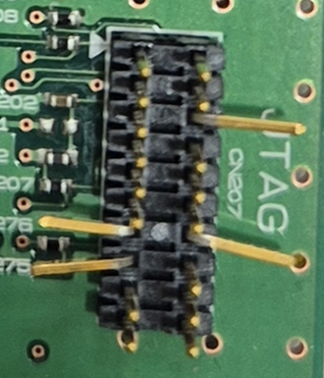
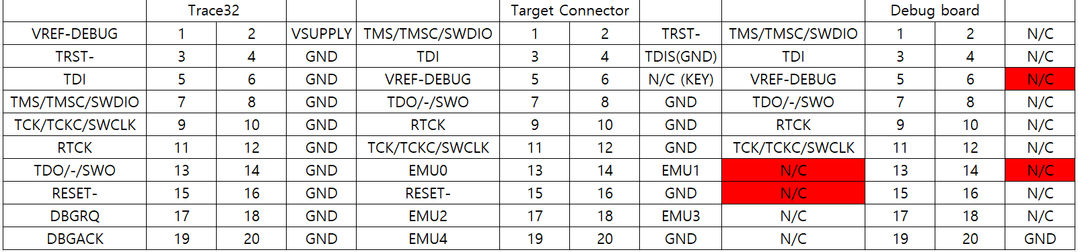
Treace32 Pin 연결

Slide 5
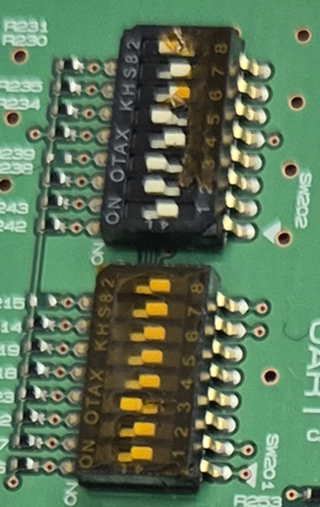
Program Download mode
 | SW201 | SW202
1 | OFF | OFF
2 | OFF | ON
3 | ON | ON
4 | OFF | OFF
5 | OFF | ON
6 | OFF | OFF
7 | OFF | OFF
8 | OFF | ON

Slide 6
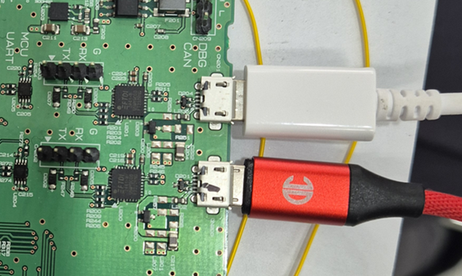
20251016 version 이후는 Uart가 2개
CR Debug
CA Debug

