Slide 1

Hyundai mobis org.
2026

Slide 2
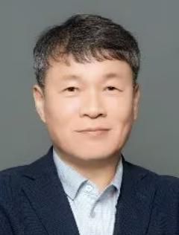
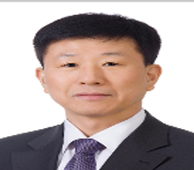

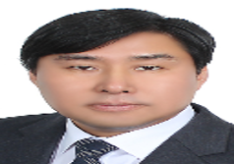


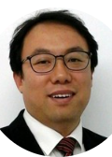


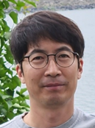
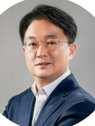
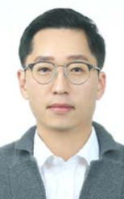
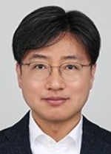
2026/01/01~
hyundai mobis organization (r&D)
HYUNDAI MOBIS
LEE, KyuSuk / CEO
1965.08.12
서울대 경영학과
ex HKMC 구매본부장
Automotive Electronics BU
JUNG, SooKyung / EVP
Chassis Safety BU
LEE, ByungHoon / SVP
Electrification/Module BU
KIM, YoungBin / EVP
Lamp BU
PARK, JungHun / VP
1967.11
홍익대
1966.01
한양대
1966.09
성균관대
1968.08
연세대
VP DemoCar Business
CHANG, JaeHo / Chief
Automotive Electronics R&D
KO, BongChul / VP
Passenger Safety R&D Gr
LEE, KyuSang / VP
1971.05
부산대
Electrification/Module R&D
LEE, Youngguk / VP
Lamp R&D Gr
LEE, HyukMin / VP
1976.01
성균관대
1971.07
울산대
1970.09
조지아텍
VP DemoCar Develop Team
JUNG, JinHyuk(Justin)/ Sr.Manager
1967.08
카이스트
AE Tech Strategy Operation Gr
CHO, YoungGi / Sr.Manager
Steering & Suspension R&D Gr
OH, SeWook / VP
Lamp Business
Management Gr
KO, HeeSong / Sr.Manager
1975.08
한양대
Electrification Engineering Gr
Kang, Hyun / Sr.Manager
Ecosystem Cooperation Team
KIM, HyoJin / Sr.Manager
Info HMI System Develop Gr
LEE, GiSik / Sr.Manager
Braking R&D Gr
Heo, JaeWoong / VP
1974.08
서울대
Drive System R&D Gr
LEE, Youngguk / VP
Info HMI SW Develop Gr
CHOI, HyungJin / VP
1975.xx
홍익대
Chassis Safety Business Management Gr
LEE, HyunBok / VP
Electric Control Develop Gr
SHIN, KyuCheol / Sr.Manager
1972.04
인하대
Battery System R&D Gr
PARK, YongJun / VP
1974.09
중앙대
Semiconductor Business
PARK, ChulHong / SVP
Converter System R&D Gr
KIM, DongHyun / VP
1975.05
성균관대
1968.05
UC샌디에고대
Autonomous Driving System Develop Gr
JANG MinSoo / Sr.Manager
1977.xx
xx대
Semicon Business
Management Gr
LEE, HeeHyun / VP
Autonomous Driving SW Develop Gr
LEE, SeokJoo / VP
Electrification/Module Business Management Gr
Park, HanSeok / VP
1973.10
연세대
1975.01
중앙대
1976.01
고려대
Power Semicon Gr
HEO, HongPyo(Brandon) / VP
1972.02
울산대
SW Platform Develop Gr
LEE, SeungIl / VP
1976.02
한양대
System Semicon Gr
WOO, JaeHyuck / Sr.Manager
19xx.xx
xx대
AE Business Management Gr
AHN, JangMo / VP
19xx.
xx대
Power Module
Production Develop Gr
PARK, YongJun / Sr.Manager
Automotive Electronics Testing Develop Gr
LEE, JungKeun / Sr.Manager
Notes:
● 4개 BU, 1개 사업담당 / 21개 실 / 150여개 팀
● TAM : $1.6B
● SAM : $744M
● SAM breakdown (744)
ADAS 106
Body 132 (Lamp 포함)
CoGW 67
IVI 229
xEV 104
Chassis 107

Slide 3
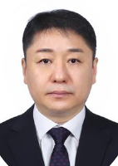
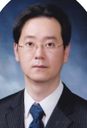
2026/01/01~
hyundai mobis organization (purchasing)
HYUNDAI MOBIS
LEE, KyuSuk / CEO
이규석 사장
1965.08.12
서울대 경영학과
ex HKMC 구매본부장
Purchasing BU
JANG, Hoyoung / EVP
장호영 부사장
1968.xx
경북대
ex 삼성전자 네트워크사업부 구매총괄
Electronic Parts Procurement Group
RYU, JinYoul / VP
류진열 상무
1970.03
충남대
ex 샤시부품구매실장
Semiconductor Parts
Procurement Team
(반도체부품구매팀)
김대곤 KIM, DaeGon(14)
Electronic Control Parts
Procurement Team
(전자제어부품구매팀)
박인수 PARK, InSoo
Autonomous Driving Parts
Procurement Team
(자율주행부품구매팀)
송두호 SONG, DooHo
Connected
Procurement Team
(커넥티드 구매팀)
류승준 RYU, SeungJun
IVI Parts
Procurement Team
(IVI부품구매팀)
한주영 HAN, JuYoung
AV Parts
Development Team
(AV부품개발팀)
이경수 LEE, KyungSoo
Part 1 ⎢ 김영서 KIM, YoungSeo(7)
(SoC, MCU, PMIC, Driver)
Part 2 ⎢ 오대석 OH, DaeSeok(6)
(Memory, SerDes, PWR Discrete)
Notes:
● TAM : $1.6B
● SAM : $744M
● SAM breakdown (744)
ADAS 106
Body 132 (Lamp 포함)
CoGW 67
IVI 229
xEV 104
Chassis 107

Slide 4
Appendix

