Slide 1
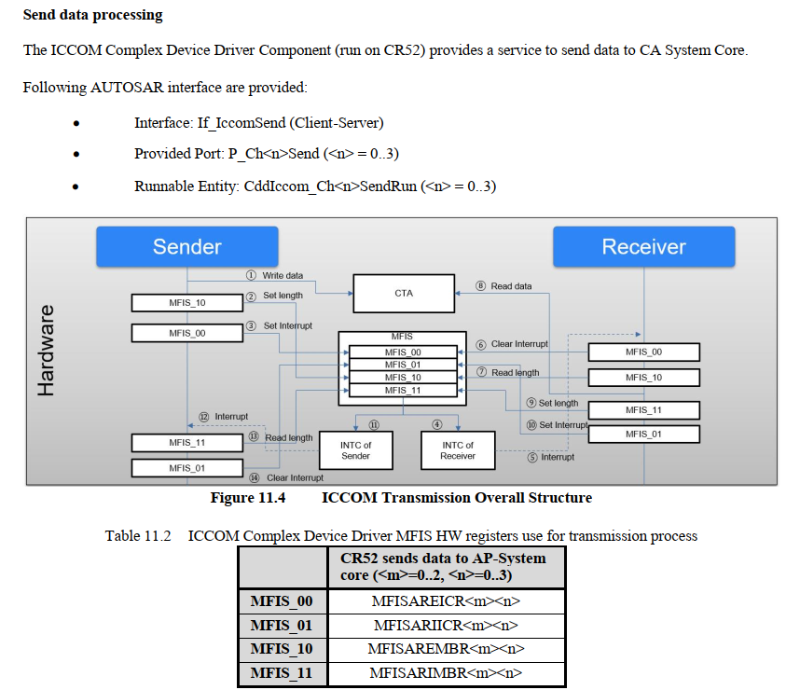
ICCOM-1
Short Name | CTA Address | Iccom Ch ID
CddIccomChannel_000 | 0x47FC7000 | 0
CddIccomChannel_001 | 0x47FC9000 | 1
CddIccomChannel_002 | 0x47FCB000 | 2
CddIccomChannel_003 | 0x47FCD000 | 3

Slide 2
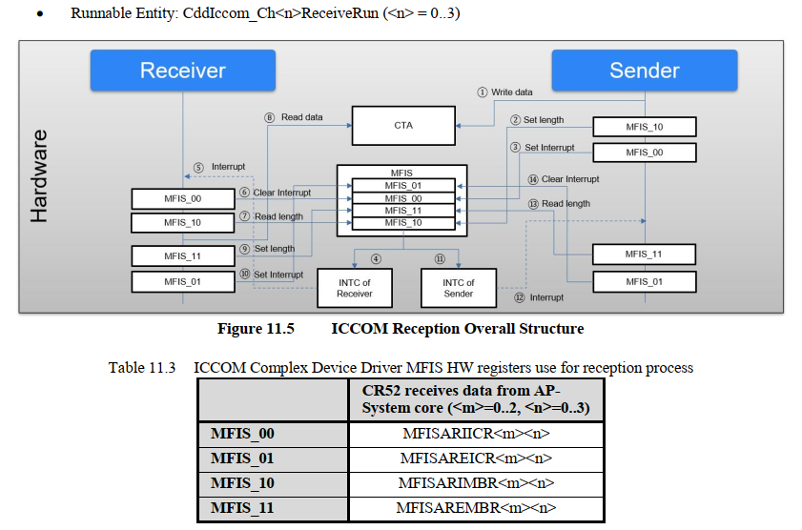
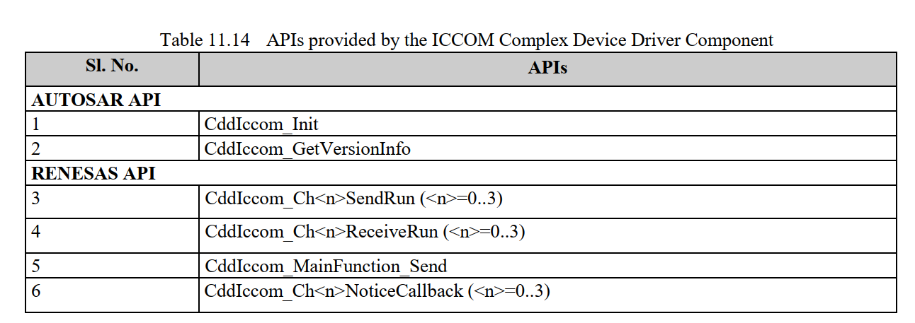
ICCOM-2

Slide 3
ICCOM-3

