Slide 1

FAE/AE Global Community
September 2022
Mazitova Elvira
ADMKD/ADMS/ADMS12 – Project Management
Automotive Business Unit
Renesas Electronics Corporation

Slide 2
Agenda
Support structure for SoC and MCU, possible other products
General steps proposal in support structure enhancement
      Global FAE community

Slide 3
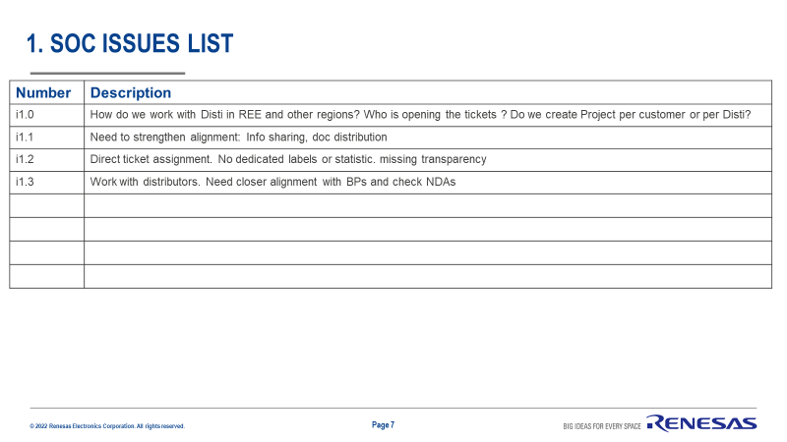
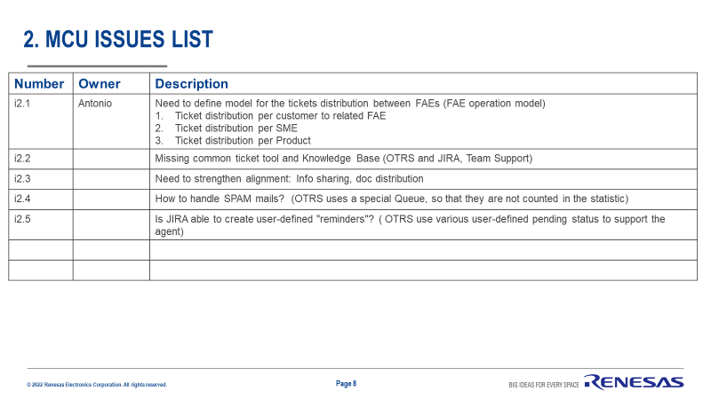

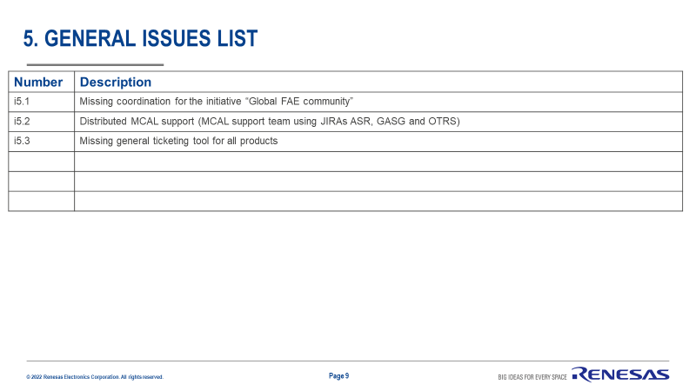
Global FAE community
Temporal support setup
(initial phase for new product)
Support structure general overview – to continue working
i5.1, I5.2, i5.3
3. Analog
Application
Sensor
Video
SoC
2. MCU
4. Power
i1.0
Disti
RECN
REA REIN REL
Radar
RECN
i2.1
REE
REA REIN REL
L1 FAE+FAE Deputy
i2.2
i1.3
i1.1
i2.4
App Eng
(TPS)
i2.5
REE
TPS_team_SoC
i2.3
TMAE_team_MCU
TPS_team_MCU
TPS_team_MCU_Tools
L2
App Eng
(FDT)
FDT_Z
…
FDT_HWA
FDT_X
Andreas T to provide list of the SWDD, ASDD
L3
SWDD
ASDD
i1.2 Direct ticket assignment
No dedicated labels or statistic
I1.4 Redmine decommissioning
i2.4 Not clear direct ticket assignment
No dedicated labels or statistic

Slide 4
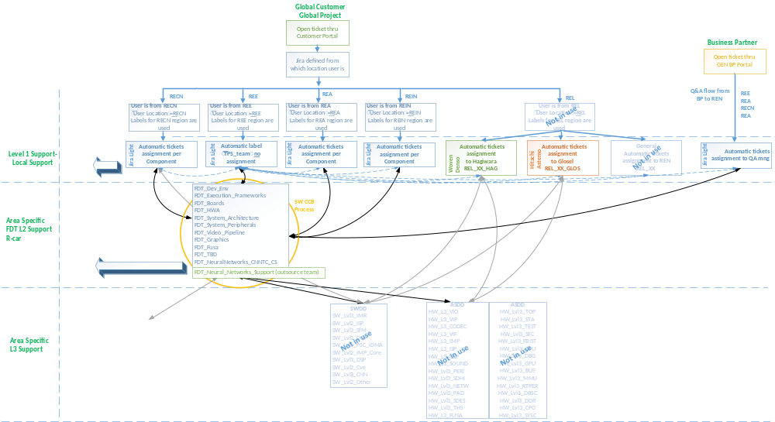
JIRA Global Support Structure (detailed view)

Slide 5
Discussed structure
21-10-2022
A-High Touch
B-Mid Touch
C-Low Touch
D-No Touch
m1
m3
m2
m4
m5
Disti FAE
REN FAE
REN FAE
Renesas FAE
L1 / FAE
Renesas FAE
L2 AGAP team
L2
L2 AE team
L3

Slide 6


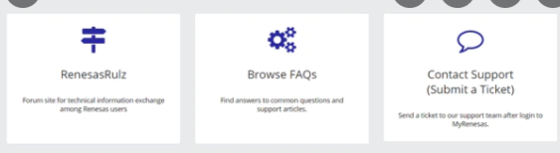

Customers Support models
09-11-2022
Model 3
Disti opens JIRA ticket on behalf of customer in a dedicated customer portal
communication b/w customer
and Disti not in REN scope;
Model 4
Disti opens JIRA ticket on behalf of customer in a Disti portal; communication b/w customer and Disti not in REN scope;
Model 5
Customer support via web
Renesas.com
Renesas Rulz
Model 1
Customer directly opens tickets in JIRA GASG in a dedicated customer portal
No disti involved
Model 2
Customer directly opens tickets in JIRA GASG in a dedicated customer portal
Disti is agent inside JIRA
A- High Touch
B-Mid Touch
C-Low Touch
D-Low Touch
A- High Touch
B-Mid Touch
A- High Touch
B-Mid Touch
e-mail
e-mail
Disti FAE - Customer
Disti FAE - Customer
Customer Portal
Customer Portal
  JIRA GASG
  JIRA GASG
Customer Portal
Disti Portal
  JIRA GASG
  JIRA GASG
Disti FAE - Agent

Slide 7
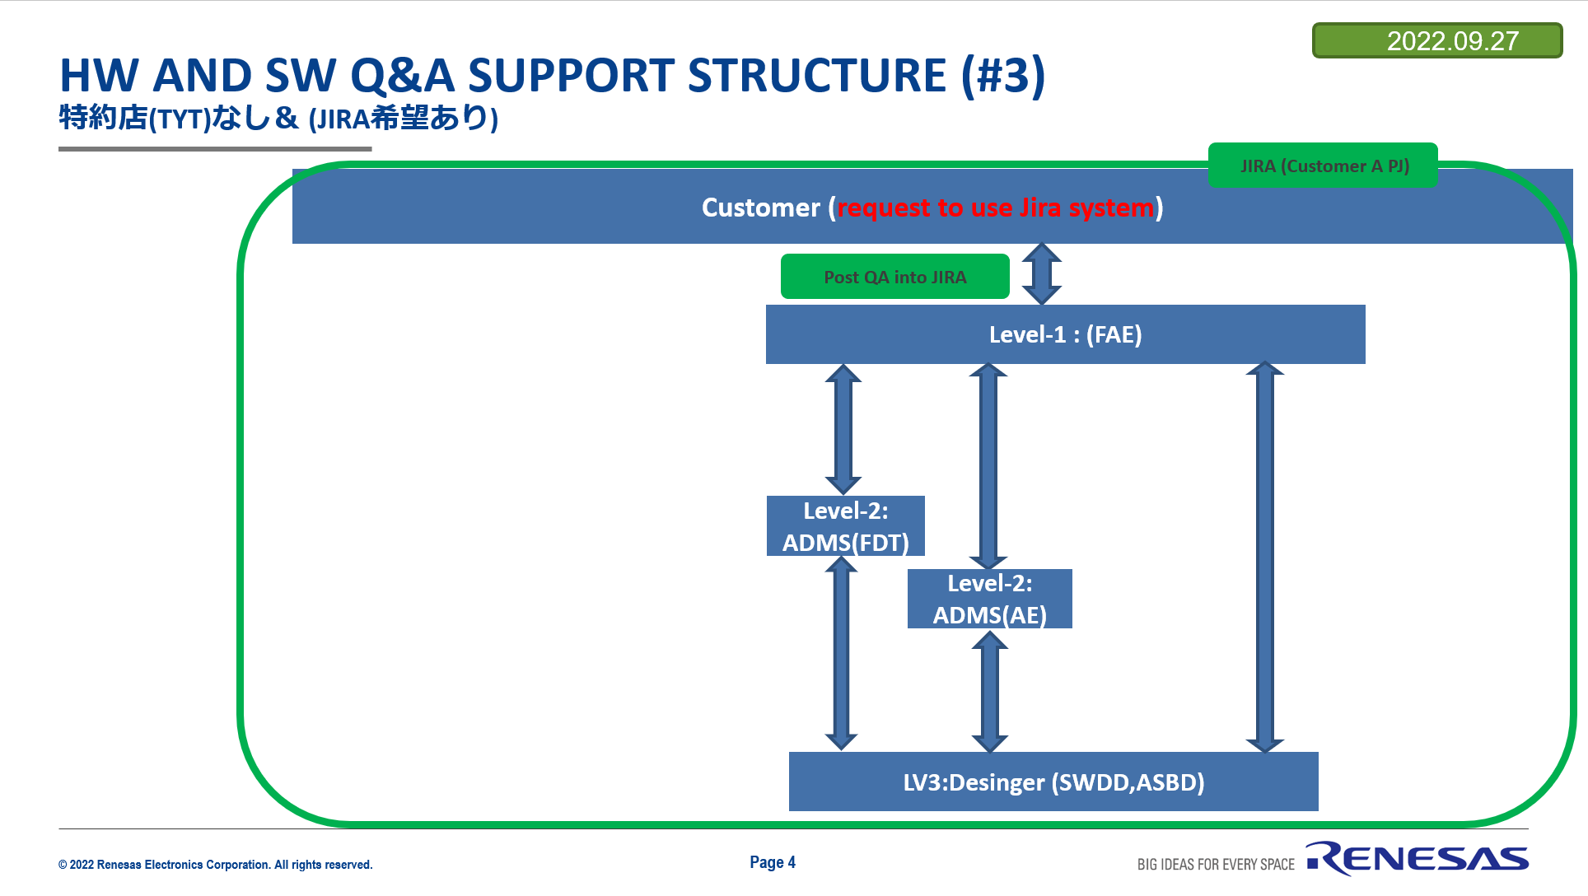
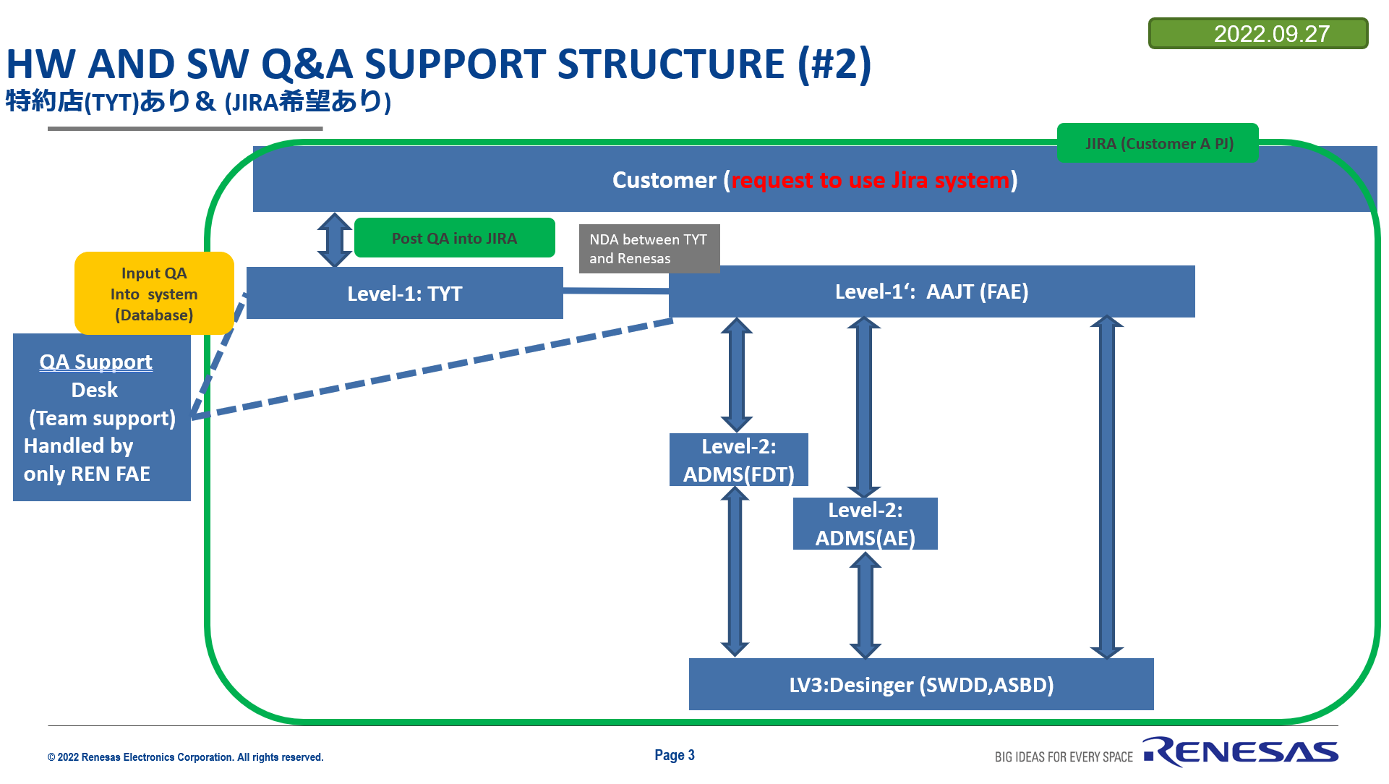
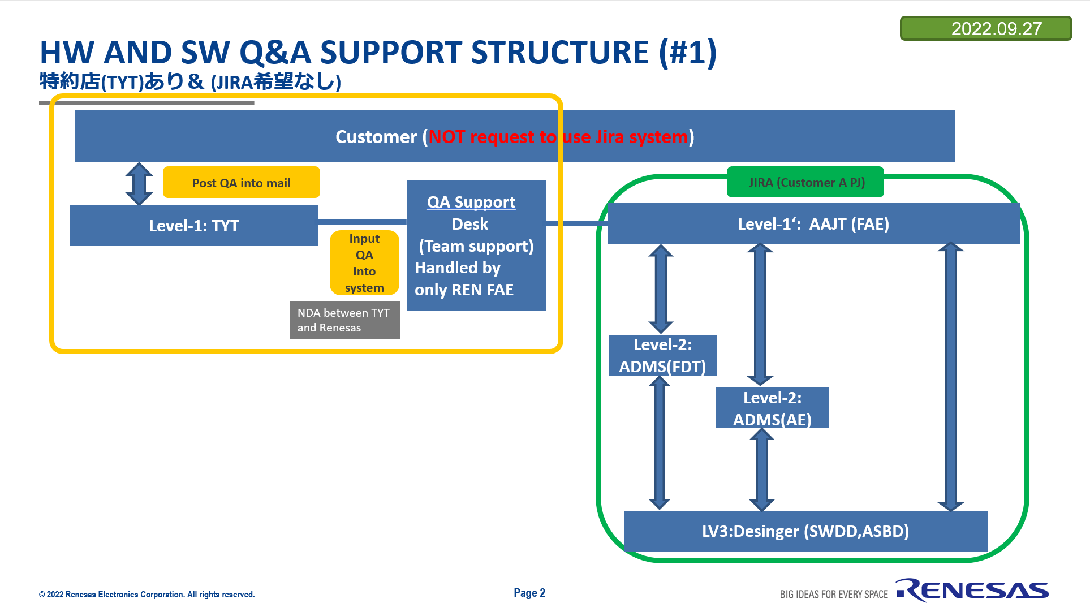
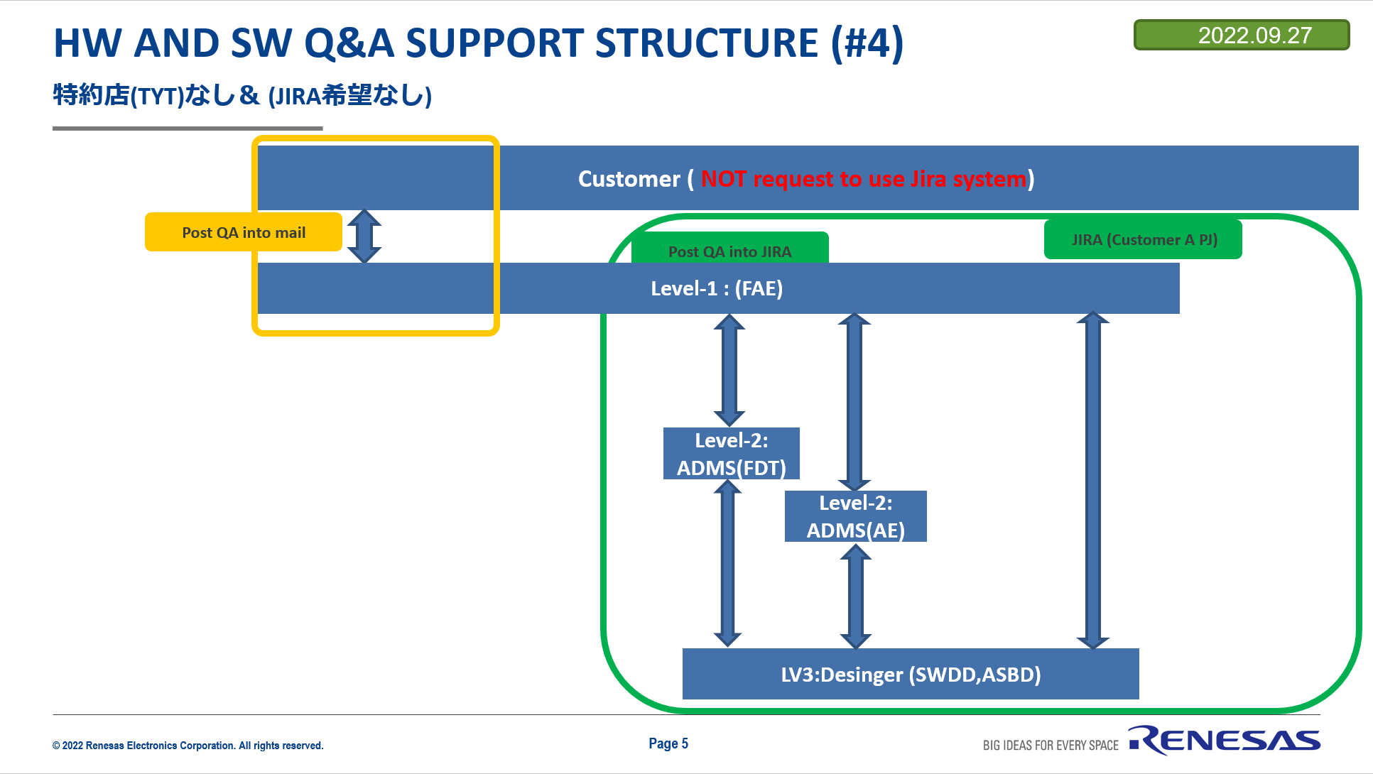
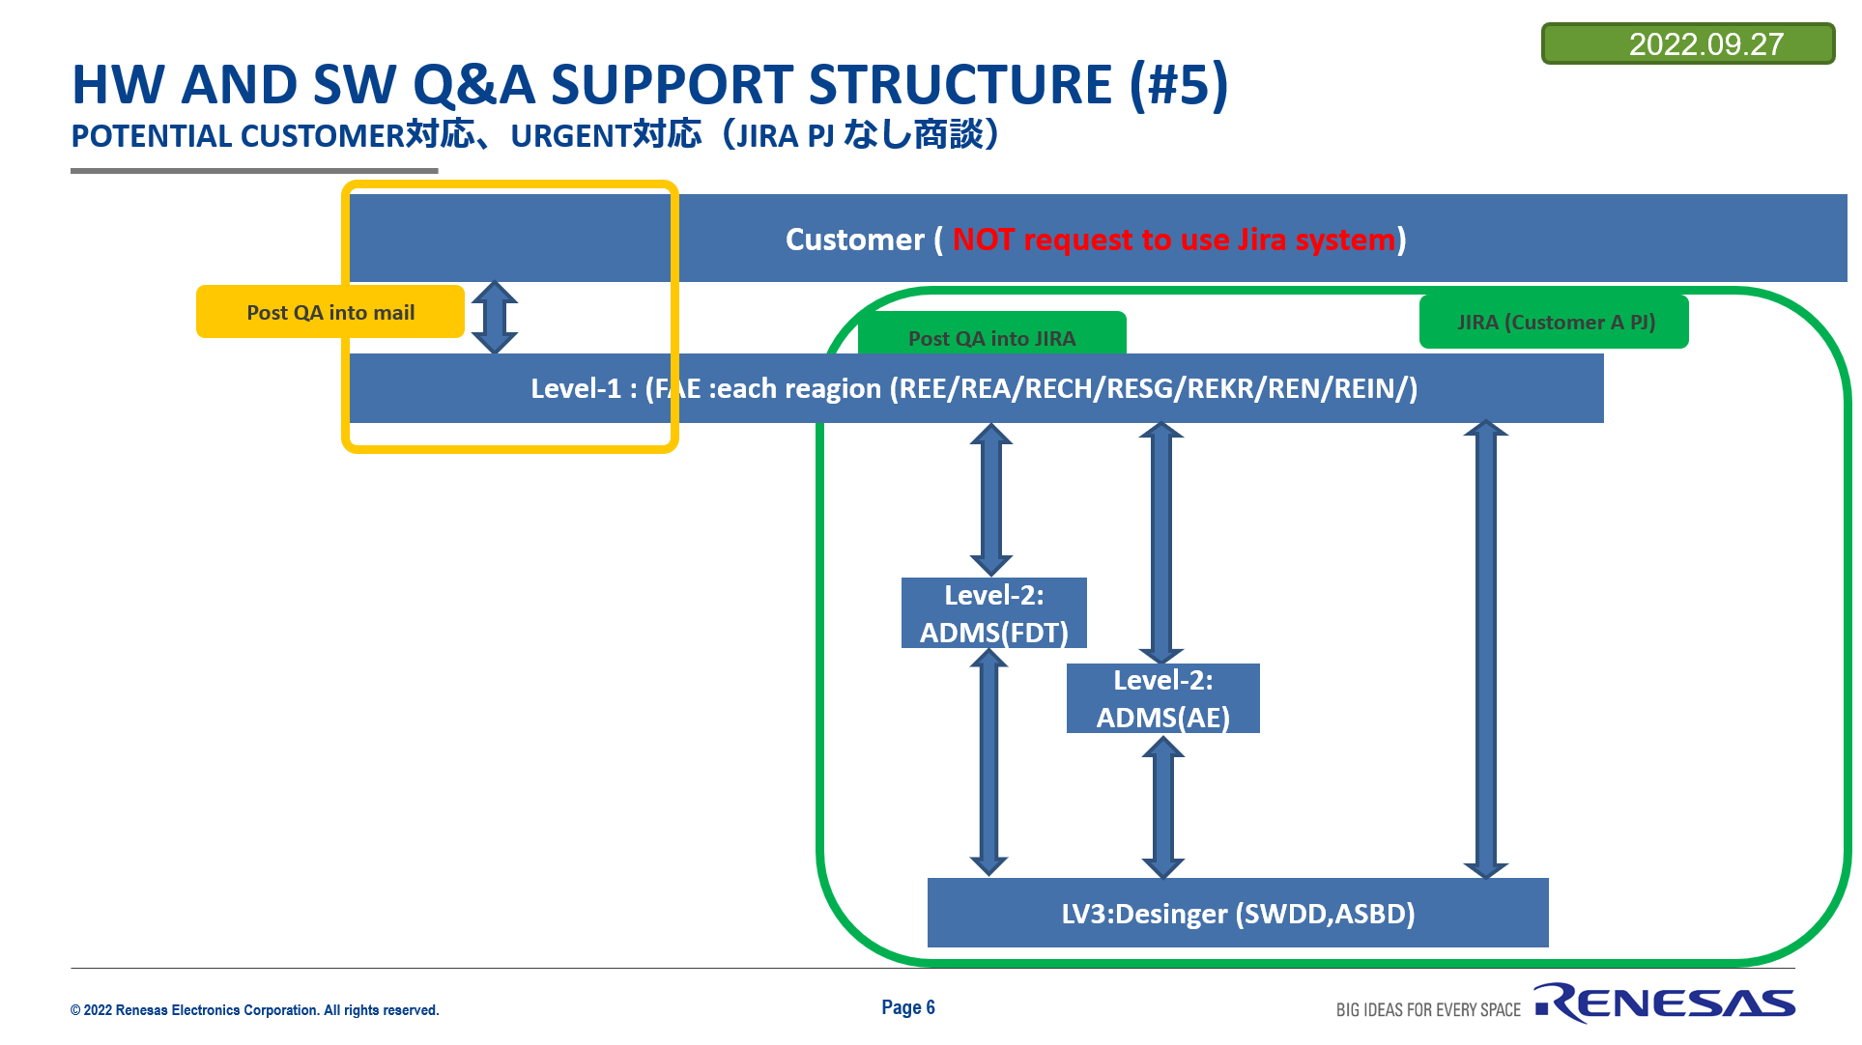
Customers Support models
09-11-2022
Model 3
Disti opens JIRA ticket on behalf of customer in a dedicated customer portal
communication b/w customer
and Disti not in REN scope;
Model 4
Disti opens JIRA ticket on behalf of customer in a Disti portal; communication b/w customer and Disti not in REN scope;
Model 5
Customer support via web
Renesas.com
Renesas Rulz
Model 1
Customer directly opens tickets in JIRA GASG in a dedicated customer portal
No disti involved
Model 2
Customer directly opens tickets in JIRA GASG in a dedicated customer portal
Disti is agent inside JIRA
A- High Touch
B-Mid Touch
C-Low Touch
D-Low Touch
A- High Touch
B-Mid Touch
A- High Touch
B-Mid Touch
e-mail
e-mail
Disti FAE - Customer
Disti FAE - Customer
Customer Portal
Customer Portal
  JIRA GASG
  JIRA GASG
Customer Portal
Disti Portal
  JIRA GASG
  JIRA GASG
Disti FAE - Agent

Slide 8
Situation JIRA/OTRS
  Actual situation with “one” label
  New situation with “more” teams needs a “hierarchy” with “sublabels”. Existing/old “TPS_team” tickets need to be migrated to new label (“TPS_team_SoC”).
Automated deceision for „sublabels“ based on component:
R-Car
RH850
…
XYZ
XYZ Team
„TPS_team_XYZ“
Member 1
Member 2
Member n
MCU Team
„TPS_team“
„TPS_team“
„TPS_team_MCU“
Member 1
Member 2
Member n
SoC Team
SoC Team
„TPS_team_SoC“
Member 1
Member 1
Member 2
Member 2
Member n
Member n

Slide 9
1. SOC issues list
Number | Description
i1.0 | How do we work with Disti in REE and other regions? Who is opening the tickets ? Do we create Project per customer or per Disti?
i1.1 | Need to strengthen alignment: Info sharing, doc distribution
i1.2 | Direct ticket assignment. No dedicated labels or statistic. missing transparency
i1.3 | Work with distributors. Need closer alignment with BPs and check NDAs

Slide 10
2. MCU issues list
Number | Owner | Description
i2.1 | Antonio | Need to define model for the tickets distribution between FAEs (FAE operation model) Ticket distribution per customer to related FAE Ticket distribution per SME Ticket distribution per Product
i2.2 |  | Missing common ticket tool and Knowledge Base (OTRS and JIRA, Team Support)
i2.3 |  | Need to strengthen alignment: Info sharing, doc distribution
i2.4 |  | How to handle SPAM mails? (OTRS uses a special Queue, so that they are not counted in the statistic)
i2.5 |  | Is JIRA able to create user-defined "reminders"? ( OTRS use various user-defined pending status to support the agent)

Slide 11
5. General issues list
Number | Description
i5.1 | Missing coordination for the initiative “Global FAE community”
i5.2 | Distributed MCAL support (MCAL support team using JIRAs ASR, GASG and OTRS)
i5.3 | Missing general ticketing tool for all products

Slide 12
16.09.2022
Proposal on the next steps
Proposal:
Define and initiate project (phases of the project)
Define prio of the scope coverage (ref to the issue list)
Define and agree on the budget of the project, phases of the project
Define working groups for each phase of the project (steering come and working level or 2 in 1)
Define schedule for each phase of the project
Kick off activity (hold kick off meeting)
Communication mng: setup re-occurring meetings and coordination of the activities

Slide 13
2. MCU

Slide 14



i2.1 Need to define model for the tickets distribution between FAEs (FAE operation model)
Option 1:
“Groom FAE”
Option 2:
Directly to SME
Registered user
Or generic e-mail address (queue)
Registered user
Or generic e-mail address (queue)
Phone call or not to use personal e-mail?
Phone call or not to use personal e-mail?
FAE prime
FAE prime
Watchers
of the tickets
FAE deputy
FAE deputy
220215 FSE_FAE Customer Responsibility.xlsx
FAE SME
FAE SME
~
~

Slide 15
i2.1 Need to define model for the tickets distribution between FAEs (FAE operation model)
Each case has to cover most comment cases for the customer support (Aprox 990%)
Scalability to consider:
      Customer
      Product
      SME (I-shape or T-shape specialist)
      Region (ree, REA, RECN, REL, REA)

Slide 16
OTS migration

Slide 17
OTRS migration – Schedule
17-08-2022
  Support over OTRS
    Dedicated support
    Major customers
    On-board to existing customer portals/projects
    Example: Bosch Unimind, Unicon
    General support
    Following customers, potential customers
    “One for all” portal/project
    Example: MCDC support for Renesas Rulz
 | July 2022 |  | August 2022 |  |  |  |  | September 2022 |  |  |  | October 2022
Activity | CW29 | CW30 | CW31 | CW32 | CW33 | CW34 | CW35 | CW36 | CW37 | CW38 | CW39 | CW40 | CW41 | CW42 | CW43
Bosch Unicon Unimind
“One for all” Project
Confluence materials update
Define Support Structure
JIRA DEV
deployment
JIRA PRD
deployment
JIRA DEV
deployment
Demo
Gather new requirements
POC1 for basic requirements:
1. e-mail communication for registered/unregistered users
2. OAuth 2.0
3. Connect few e-mail queues to one JIRA Project
POC2 for extended requirements:
Migration of the existing tickets
Support Structure
?potential JIRA PRD migration
from OTRS
Define Support Structure
~
Now
Notes:
カスタムフィールド
・除外：案 - 代替案で対応出来ている
・SDK Type判定：案 - 代替案で対応出来ている、S4よりも後でよい
・ツールチェインかサポートコンパイラの情報：案 ★ - 代替案で対応出来ている
・SPILS - ？(値の追加なので背景が必要)
・SW OS Name に Zephyrを追加：Zephyr対応前に必須 ← OTLINTに紐づいている？
V4H Zephyr, Vision FWKのチケット作成（やり方はしっている人前提）
CPUコアの属性の追加が必要。仕様決めが発生する
5月末に先行リリース（チケットで対応しなくても可）
6月にトライアル
7月パッケージリリース
S4のCONFDB対応をいつにするか（初めての人が多い）
仕様見直し。Custom fieldの変更が必要。～５月末
6月にチケット作成
ターゲット: 6/M or 7/M
チケット追加Trial パッケージ作成本番リリース
1V3H/V3M4/E5/E6/E2Non SDK4/E?5/E?6/E?3ZephyrOSパワポだと5/Mだが→5/Eシフト予定6/E7/E4VisionFWKパワポだと5/Mだが→5/Eシフト予定6/E7/E5S4パワポだと5/Eだが→5/Mシフト予定6/M7/M

Slide 18
FAE/AE mailing list

Slide 19
FAE mailing list
TBD

Slide 20
Distributors on-boarding (RENJRC-3899)
GENDITI_ABU

Slide 21
      AM & EM
18-01-2023
Distributors on-boarding – original proposal & questions
GEO | Distributor | Regional Sales leader | SoC Ticket Receiver | SoC Ticket Watcher | MCU Ticket Receiver | MCU Ticket Watcher | SoC GSS | MCU GSS | Regional FAE mng (added as watcher) | Comment
AMERICAS | AVNET |  | AGAP Jira „TPS_team_SOC“ | Quan Li | AGAP Jira „TPS_team_MCU“ | Hardik Shah | REA_FAE | TPS_team_MCU or TMAE_team_MCU | SoC & MCU Fred Gordon A&P Mark Lissner | REA_FAE Quan Li (REL/US) prime Jeffrey Booker (REA/US) alternative/watcher TPS_team_MCU – no direct tickets assignment
EMEA | AVNET |  | AGAP Jira „TPS_team_SOC“ | N/A | AGAP Jira „TPS_team_MCU“ | N/A | TPS_team_SOC | TPS_team_MCU or TMAE_team_MCU | SoC & MCU Andreas Erlebach A&P Joerg Weeger
CHINA | Yuban E-Touch Teampo |  | Jeff Fang | Haijun Chen; Gaowei Li | Lina Chang; Sophia Jiang | Jianfeng Wang; Yi Zhan | RECN_FAE | RECN_FAE? | SOC&MCU : Tao Yu A&P Power : Barney Hu Power management : Barney HU Analog : Jason Lu | Need MCU label for RECN who is in the RECN MCU team? RECN_FAE Asignee: Haijun Chen (REL/CN) Deputy/watcher Gaowei Li (REL/CN) Jing Yan (REL/CN)
JAPAN | Hagiwara Tokai Ryosan Shinko Glosel Ryoden Tachibana Ryosho |  | Kunihiro Tosho Toru Aoyama | - | Takayuki Kaneko Kyoukou Gi | - | REL_FAE REL_SW REL_HW REL_Fusa REL_Tools |  | Tbd.... | Do we need to extend the labels base on the REL FAE support structure?
KOREA | Gentech Leaderstech |  | Tony Cho | Neo Kim Mason Shin Luis Kim | Luis Kim | Mason Shin Neo Kim Tony Cho | REKR_FAE | REKR_FAE? | RECN All:HJ Cho | REKR_FAE Primary: Tony Cho (REKR/KR) Secondary: Neo Kim (REKR/KR) Deputy/Watcher: Seungmin Shin (REKR/KR) Tony Cho (REKR/KR) Neo Kim (REKR/KR)
INDIA | Rabyte Macnica Hagiwara |  | Nagesh Gad | Amit Sharma | Rachit Choudhary Pramod Patil | Nagesh Gad | REIN_FAE | REIN_FAE? | SoC & MCU Srikhanth Nagarajan A&P Vrao Pendyala | REIN_FAE Prime: Ravi Thankaraj (REL/IN) Deputy/Watcher: Mohammed Yaseen (REL/IN)
TAIWAN | Koryo WT Micro |  | Paul Wang | Yasuhiro Yamakoshi Yajun Wu | Paul Wang | N/A | RETW_FAE? |  | Taiwan All Victor Wang | No GSS; need label for RETW_FAE; Who is prime and who is deputy?
APAC OTHERS | Macnica Avnet WT |  | AGAP Jira „TPS_team_SOC“ |  | AGAP Jira „TPS_team_MCU“ |  | TPS_team_SOC | TPS_team_MCU or TMAE_team_MCU | SG/SE Asia : TP Tay

Slide 22
Issue statements
Issue statements:
Alignment with GSS
Proposal for the tickets distribution below is not aligned with Global Support structure - Global Support Structure
Labels overview: GSS_labels_overview_v.1.0.xlsx
      AI: Need confirmation: for REE, RECN, REIN, REKR can existing Support structure to be used?
      AI: Need to define Support structure in Taiwan (as part of GSS), for each JIRA component – JIRA “light”
      AI: Need confirmation: Do we involve REN FAE in to communication model ?
      AI: what is the support structure for MCU in other regions ? As of now for MCU tickets are re-direct to the same FAE in the regions
      AI: need to define support structure in the REL; REL has broader FAE team and also usage of other tools (complex issue)
      AI: should GENDISTI work in similar was GENBP; first assingemnet to be done to QA person; Who will be controlling Disit from REN side?
Work with Distributors
      Proposal to setup General Distributors Portal (GENDISTI) it will work for all regions except of REL;
      Base on the models which are presented (sl 22) REL distributors already working base on Model 2; it means if they will get access to GENDISTI, then they will be able to see complete project as they work as JIRA Agents; Can this be covered by NDA ?

Slide 23
Next steps
Proposal from JIRA Admin Team
Clarify AI listed in previous slide
Create GENDISTI portal (to be used for all regions except of REL)
  Each Disti will see ticket only from it’s own organization, but for all customer with which this Disti is working
Define support structure in REL

Slide 24
Customers Support models for high touch customers
09-11-2022
Model 3
Disti opens JIRA ticket on behalf of customer in a dedicated customer portal
communication b/w customer
and Disti not in REN scope;
Model 1
Customer directly opens tickets in a dedicated customer portal
No disti involved
(Customer or product based)
Model 2
Customer directly opens tickets in a dedicated customer portal
Disti is agent inside JIRA
A- High Touch
B-Mid Touch
A- High Touch
B-Mid Touch
A- High Touch
B-Mid Touch
Disti FAE - Customer
Customer Portal
Customer Portal
  JIRA GASG
  JIRA GASG
Customer Portal
  JIRA GASG
Disti FAE - Agent

Slide 25
Customers Support models for low touch customers
09-11-2022
Model 4
Disti opens JIRA ticket on behalf of customer in a Disti portal; communication b/w customer and Disti not in REN scope;
Model 5
Customer support via web
Renesas.com
Renesas Rulz
Model 6 (under development)
Customer send e-mail, tickets opens automatically in JIRA GASG in a free for all customer project
No disti involved
C-Low Touch
D-Low Touch
D-Low Touch
e-mail
e-mail communication
Disti FAE - Customer
  JIRA GASG
Customer Portal
  JIRA GASG

Slide 26

Customers Support models for high/low touch customers
09-11-2022
Model 7
FAE or Online AE enters JIRA ticket on Agent side.
BU AE team are 1st responders
Vertical / Regional
High Touch/Low Touch
JIRA GASG
#1 case – majority

Slide 27
Avnet silica Project Structure (for R-Car) – Europe (RENJRC-3780)
      Marie-Claire Proposal
REE ABU
(Wido)
Sales
ABU ADMKD
(Marie-Claire, Eric)
Marketing,
Facilitator
Avnet Silica's
Customer
Avnet Silica
Local FAEs
Avnet Silica Sales
Avnet Silica “R-Car FAEs”
Jira
Coordination between Actia and Renesas’s teams
AI Follow Up & Ope issue tracking
Set up & drive regular Projet meeting with customers
Escalatont rigger
REE ABU TPS team (Frank)
Level 1
ABU ADMKD (Anne)
Level 2
ABU (HW/SW development)
Level 3

Slide 28
notes
For each project at distributor’s customer we will create a sub-project on the distributor’s Jira portal.
Many small customers in this case.
Several distributors – lead are 2 (EBV, Avnet Silica), others later.
Distribution customer has no access to Jira.
Open: has Avnet Silica experience with Jira?
Products: R-Car Gen3e, V3x
  New for Europe but existing distribution support model in other regions (Korea, Japan etc) in similar way. Consistency (across regions) to be considered.
  What about single Jira distribution customers' portal; then sub-project per customer -> distributor's name_customer's name.
  See queues associate to each customer -> can sort by distributor.
  This is simpler to handle/maintain from Jira management point of view.
  No NDA between distributor's customers and Renesas => avoid direct support
  Next step: Elvira to check setup in other regions

Slide 29
Additional slides

Slide 30
REN Tools and products overview

Slide 31
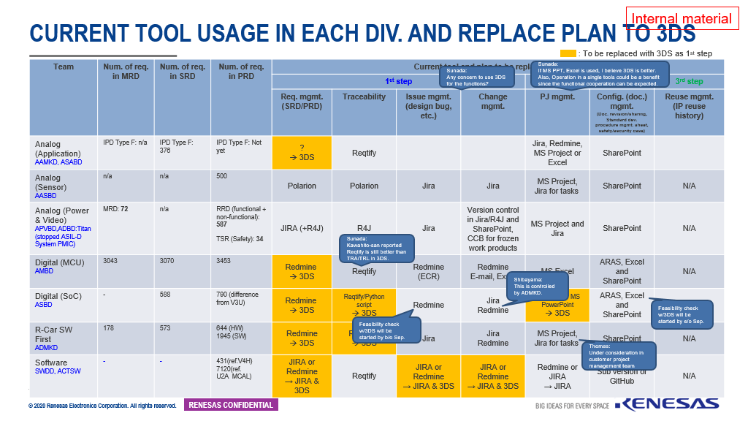
Tools and products overview
Sources
Requirement Engineering PJ_Rollout_Phase1_charter.pptx
220215 FSE_FAE Customer Responsibility.xlsx

Slide 32
Renesas.com

